Slide 1
Getting Started with SharePoint Framework Extensions
Introduction to Extensions & Application Customizers

Slide 2

Introduction to Extensions & Application Customizer
SPFx Extensions
Debugging & Testing Extensions
Deploying Extensions
Application Customizers
Notes:
In this unit, you'll learn what SharePoint Framework extensions are and how you can use them to customize SharePoint. Then, you'll learn about one type of extension: application customizers.

Slide 3
SharePoint Framework Extensions
Extend the SharePoint user experience
Customize notification areas, toolbars & list data views
Available in Modern pages, lists, and libraries
SharePoint Online
SharePoint Server Subscription Edition
SharePoint Server 2019
Used to implement popular customizations from previous development models
Delegate controls & ScriptLink
Client-Side Rendering & JSLink
Custom Actions
Notes:
SharePoint Framework extensions enable developers to customize and extend the SharePoint user experience. You can use them to customize notification areas, list toolbars, list menus, and list data views.
Microsoft introduced extensions in the SharePoint Framework to allow customers to implement some of the same customization options available in classic sites. Extensions will only work in the modern SharePoint experience and are intended to serve as the modern option for the following options in the classic experience:
- delegate controls and `ScriptLink`
- client-side rendering (CSR) and `JSLink`
- custom actions
Because they only run in the modern experience, you can only use SharePoint Framework extensions in SharePoint Server 2019, SharePoint Server Subscription Edition, and SharePoint Online.

Slide 4
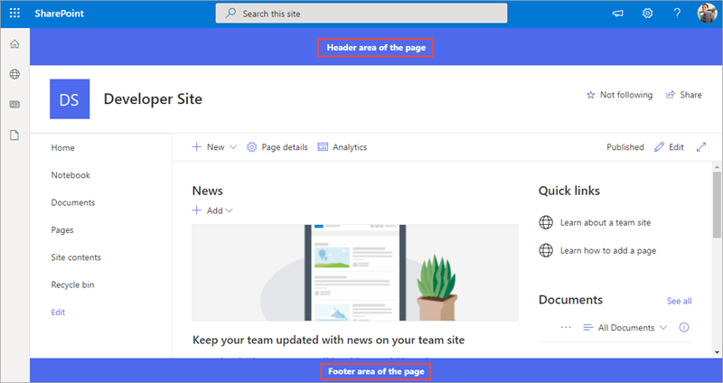
Application Customizers
Add script to any page, header & footer controls
Notes:
Let's look at the first type of extension: the application customizer. This extension is intended to be the modern replacement to the legacy delegate controls and `ScriptLink` property.
Application customizers enable you to do two things:
- add script to all pages in a site collection
- set the HTML on two well-known `<div>` elements on the page that serve as headers and footers

Slide 5
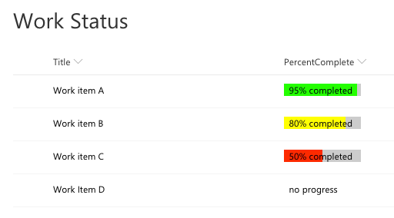
Field Customizers
Customize rendering of a list column in modern lists
Notes:
The next type of extension is the field customizer. This extension is intended to be the modern replacement to the legacy client-side rendering (CSR) framework and `JSLink`.
Field customizers enable you to define the HTML within a cell in a list view. In the following screenshot, notice the **Percent Complete** column is rendered with custom colored bars instead of plain text:

Slide 6
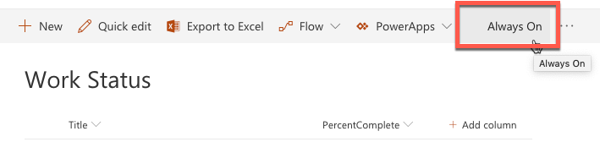
Command Sets
Add buttons to list & library toolbars & context menus
Notes:
The last type of extension is the command set. This extension is intended to be the modern replacement for legacy custom actions.
Command sets enable you to add buttons to list and library toolbars or to the context menu of items within a list.

Slide 7
Project Structure
.vscode: includes Visual Studio Code integration files
config: includes all config files
dist: contains output from all bundle processes
lib: created automatically on builds – contains pre-bundled built files
node_modules: created automatically when installing all package dependencies with a package manager
release: contains output from production bundle processes
sharepoint: contains assets needed for deployment
src: this is the main folder of the project, it includes the extension, styles, and a test file
temp: created automatically on builds - contains local dev webserver files
Notes:
The Yeoman generator for the SharePoint Framework creates the scaffolding (*folders & files*) for a new SharePoint Framework project. After building the project the first time, you'll see even more folders and files present. Just like a .NET Framework project, some of the generated files are temporary and shouldn't be kept in source control.
Let's look at the folders in a newly created and built SharePoint Framework project:
![Screenshot of a SharePoint Framework project in VS Code](../media/02-project-structure.png)
- **.vscode**: This folder contains Visual Studio Code specific files.
- **config**: This folder contains configuration files used by the project's various build tasks. You'll edit these files as necessary depending on the types of components you're creating and for specific situations, such as the site to test extensions or adding references to external libraries.
- **dist**: This folder contains the files generated when you bundle your project, regardless of which switch you use. The unminified JavaScript files and source maps contained in this folder are used when you run in debug mode.
- **lib**: This folder, created automatically when you build the project, contains the temporary files generated from the compilation and transpilation of TypeScript to JavaScript and SCSS to CSS files.
**node_modules**: This folder is created automatically when installing package dependencies using the `npm install` command.
**release**: This folder contains a subfolder named **assets** that contains the files generated when you bundle your project using the `ship` or `production` switch. These files are deployed to the CDN. This folder also contains two additional subfolders that contain manifest files.
- **src**: This folder contains all the source code for your project.
- **temp**: This folder, created automatically when you test the project, contains files used by the local development web server.
> [!NOTE]
> The **dist**, **lib**, **node_modules**, and **temp** folders should not be committed to your source control solution because they are automatically generated by the build process and when installing or restoring dependencies.
>
> These folders are similar to the **bin**, **obj**, and **packages** folder generated in a .NET project.

Slide 8
Debugging & Testing Extensions
The SharePoint workbench doesn't support testing extensions
Can still build and host extension project locally while testing in a remote SharePoint site
Configurations added to each project by the SPFx Yeoman generator simplifying loading SharePoint sites
Instructs SharePoint to load SPFx & manifest file from https://localhost
Notes:
Now let's look at how you can debug and test SharePoint Framework extensions. The SharePoint workbench doesn't support testing extensions. However, you can still build and host extensions projects locally while debugging and testing in a remote SharePoint site.
To test an extension, you include special query string parameters to the URL of a live SharePoint modern page, list or library. These parameters instruct SharePoint to do the following things:
- load the SharePoint Framework on the page if it isn't already present
- the location of the **manifest.js** file from the local web server that tells SharePoint what custom components can be put on the page
- which component the SharePoint Framework should load and put on the page
- additional properties specific to each component
The Yeoman generator for the SharePoint Framework simplifies this process fo you by creating a configuration that the **gulp serve** task uses to create the debugging URL. These settings are defined in the **./config/serve.json** file.
When SharePoint receives the request with these query string parameters, it will first prompt the user to confirm they want to load debugging scripts. SharePoint does this same technique could be used in a phishing attack. Therefore, you should only load the debugging scripts if you are sure you initiated the request.

Slide 9
Deployment
Extension deployment utilizes existing Feature framework
Application customizer: <CustomAction>
Field customizer: <Field>
Command set: <CustomAction>
Deployment similar to web parts
Upload SharePoint Package to tenant | site collection app catalog
Install app
Some extensions type support tenant-wide deployment
Notes:
The deployment for extensions is similar in many ways to deploying web parts. The existing SharePoint Feature framework is used to provision assets into a SharePoint environment.
Application customizers and command sets are provisioned in an environment using the `<CustomAction>` element. Field customizers are provisioned into a SharePoint environment as site columns that are defined using the `<Field>` element.
When it comes to deployment, the difference between web parts and extensions is that the web part provisioning process is more transparent than extensions, which require more manual work.
When the SharePoint Framework build process creates the SharePoint package, it generates the **\*.webpart** file and SharePoint Feature that's used to provision the **\*.webpart** file to the Web Part Gallery. This is done using the component's manifest and other various project configuration files.
However with extensions, these files must be manually modified prior to packaging to get the right settings.

Slide 10
Tenant Wide Deployment
Centralized control of which extensions are available across tenant or site collection
Consistent end-user experience across all sites
Consistent deployment across all sites
Automatically enable functionality on newly created sites
Notes:
Application customizers and list view command sets support tenant wide deployment. Tenant wide deployment allows you to have centralized control of which extensions are automatically available across all sites in a tenant or all sites in a site collection. This deployment option enables you to easily implement a consistent user experience across these sites.

Slide 11
Tenant Wide Deployment
Automatically make extension available to all sites in the tenant or all sites in a site collection
Supported for application customizers and list view command sets
Can use with tenant or site collection app catalogs
Set skipFeatureDeployment attribute in package-solution.json to true to enable
ClientSideInstances.xml file contains information about the extension including values of the public properties
Notes:
Tenant wide deployment can be used when deploying a package to the tenant app catalog or to a site collection app catalog. In the case of deployment to the tenant app catalog, tenant wide deployment makes the extension automatically available to all sites in the tenant. In the case of deployment to a site collection app catalog, tenant wide deployment is really site collection wide deployment. That is, it only makes the extension automatically available to the sites in the site collection where it was deployed.
Two elements of a project must be set to enable tenant wide deployment of an extension. First, the `skipFeatureDeployment` attribute in the **./config/package-solution.json** file needs to be set to **true**. Second, the project must contain a **ClientSideInstances.xml** file in the **./sharepoint/assets** folder. The **ClientSideInstances.xml** file contains information about the extension including values of the public properties.

Slide 12
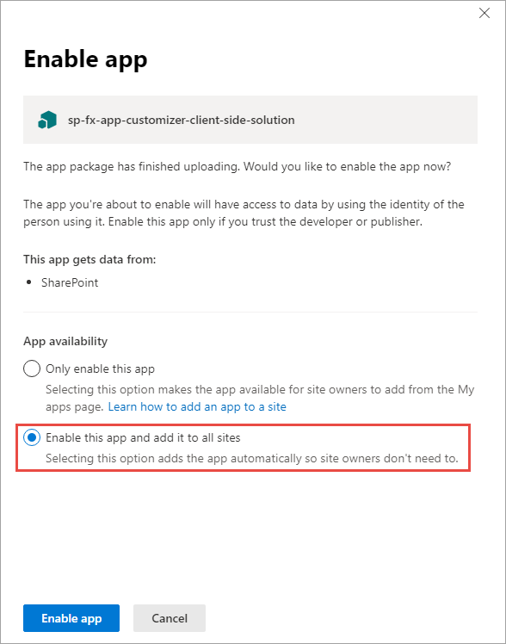
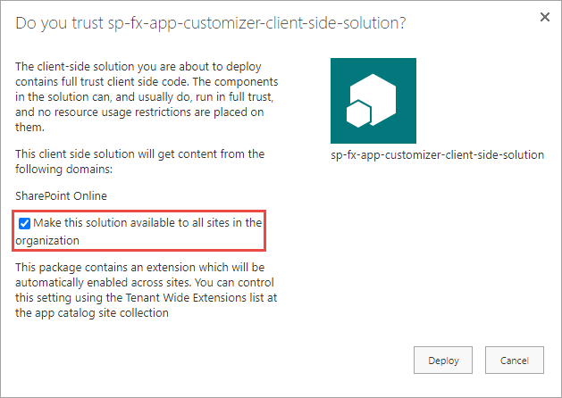
Tenant Wide Deployment
Enabling tenant wide gives the admin option to make extension available across sites
To do so they must select appropriate option when package is deployed
Notes:
It's important to note the enabling tenant wide deployment in a project just gives the administrator deploying the package the option to automatically make the extension available across all sites in the tenant or all sites in a site collection. To do so they must select **Enable this app and add it to all sites option** in the **Enable app** dialog when using the modern app catalog experience or by selecting **Make this solution available to all sites in the organization** when using the classic app catalog experience.
Again, even though the user interface described above may suggest otherwise, selecting one of these options when deploying to a site collection app catalog will only make the extension automatically available to sites in the site collection where it was deployed.
If the administrator chooses to automatically make the extension available across all sites in the tenant or all sites in a site collection, the values contained in the **ClientSideInstances.xml** file are used to add an entry into the **Tenant Wide Extensions** list.
To disable tenant wide deployment of the extension, set the `skipFeatureDeployment` attribute in the **./config/package-solution.json** file to **false**. You can optionally delete the the **./sharepoint/assets/ClientSideInstances.xml** file as well.

Slide 13
List: Tenant Wide Extensions
Control tenant wide deployments with this app catalog list
Column | Type | Description
Title | string | Title of the entry. Can be descriptive entry for the registration. Doesn’t have to match anything, just for your reference
Component ID | GUID | Manifest ID of the component. Has to be in GUID format and component must exists in the app catalog.
Component Properties | string | Optional component properties.
Web Template | string | Can be used to target extension only to specific web template.
List Template | int | List type as a number.
Location | string | Location of the entry. There are different support locations for application customizers and List View Command Sets.
Sequence | int | Sequence of the entry in rendering.
Disabled | Boolean | Enabled state of the deployment.
Notes:
App catalog sites contain a **Tenant Wide Extensions** list, which can be used to manage SharePoint Framework extension activations. This list may be hidden. If it is not shown in the site contents page of the app catalog site, it can be accessed by adding **/Lists/TenantWideExtensions/AllItems.aspx** to the app catalog site URL.
To disable tenant wide deployment for an extension, set the value of the **Disabled** field for the appropriate item in the **Tenant Wide Extensions** list to **true**.

Slide 14
Application Customizers
Add HTML or JavaScript to all pages in a SharePoint site
Similar to pre-SPFx / classic mode customizations
Delegate control
ScriptLink control
Example scenarios
Add script to every page
Add 3rd party libraries to every page (ie: Azure Application Insights)
Add notice to all pages such as: alerts, news or privacy
Notes:
Now let's look at one type of SharePoint Framework extension: the application customizer. Application customizers enable you to do two things:
- add script to all pages in a site collection
- set the HTML on two well-known `<div>` elements on the page that serve as headers and footers
This type of extension is intended to be the modern experience replacement to the classic experience's delegate control and `ScriptLink` control. Some common uses for application customizers include the following:
- **add script to every page**: If you need to add JavaScript to all pages in your site, the application customizer is perfect for this scenario.
- **add third-party libraries to all pages in a site**: Similar to the previous scenario, you can use an application customizer to install a third-party service or library for monitoring or telemetry tracking in a site, such as Azure's Application Insights. The application customizer is used to add the necessary reference to the JavaScript library to all pages and do any required configuration.
- **add notice to all pages**: Application customizers are used to add script to a page. You can use this approach to display news, privacy messages or alerts to all your users easily using application customizers.

Slide 15
Application Customizer - Placeholders
Two well-known placeholders exist on all pages
Header (just below Office 365 suite bar)
Footer (bottom of page)
Placeholders are sticky & always visible
Notes:
In addition to adding script to all pages, application customizers also enable developers to add HTML to two well-known elements on all pages in a site.
These two elements, called *placeholders*, are located at the top and bottom of a page. The top placeholder is a `<div>` that spans the entire top part of the page just below the Office 365 suite bar.
The bottom placeholder acts as a footer. This `<div>` spans the width of the page.
Both placeholders are sticky in the sense they remained pinned in the browser and don't scroll with the page.

Slide 16
Application Customer
export interface IHelloAppCustomizerApplicationCustomizerProperties {
prefixString: string;
}
export default class HelloAppCustomizerApplicationCustomizer
extends BaseApplicationCustomizer<IHelloAppCustomizerApplicationCustomizerProperties> {
private _topPlaceholder: PlaceholderContent | undefined;
private _bottomPlaceholder: PlaceholderContent | undefined;
@override
public onInit(): Promise<void> {
// this is where you do your work
}
private _onDispose(): void {
}
}
Notes:
To write to a placeholder you must first get a reference to it from the application customizer. In this code, notice the two private members `_topPlaceholder` and `_bottomPlaceholder`. You should always first check if you have a reference to the placeholder before writing to it. Otherwise, you can run into errors as you can't have more than one reference to it.
Obtain a reference to the placeholder with the `placeholderProvider` object by calling `this.context.placeholderProvider.tryCreateContent()` method.

Slide 17
Demo Creating SharePoint Framework Application Customizers

Slide 18

Summary
SPFx Extensions
Debugging & Testing Extensions
Deploying Extensions
Application Customizers

Slide 19
Reading further
Overview of the SharePoint Framework
https://learn.microsoft.com/sharepoint/dev/spfx/sharepoint-framework-overview
Overview of SharePoint Framework Extensions
https://learn.microsoft.com/sharepoint/dev/spfx/extensions/overview-extensions
Use Page Placeholders from Application Customizer
https://learn.microsoft.com/sharepoint/dev/spfx/extensions/get-started/using-page-placeholder-with-extensions
Tenant Wide Deployment of SharePoint Framework Extensions
https://learn.microsoft.com/sharepoint/dev/spfx/extensions/basics/tenant-wide-deployment-extensions

Slide 20
Thank you.

